Slide 1
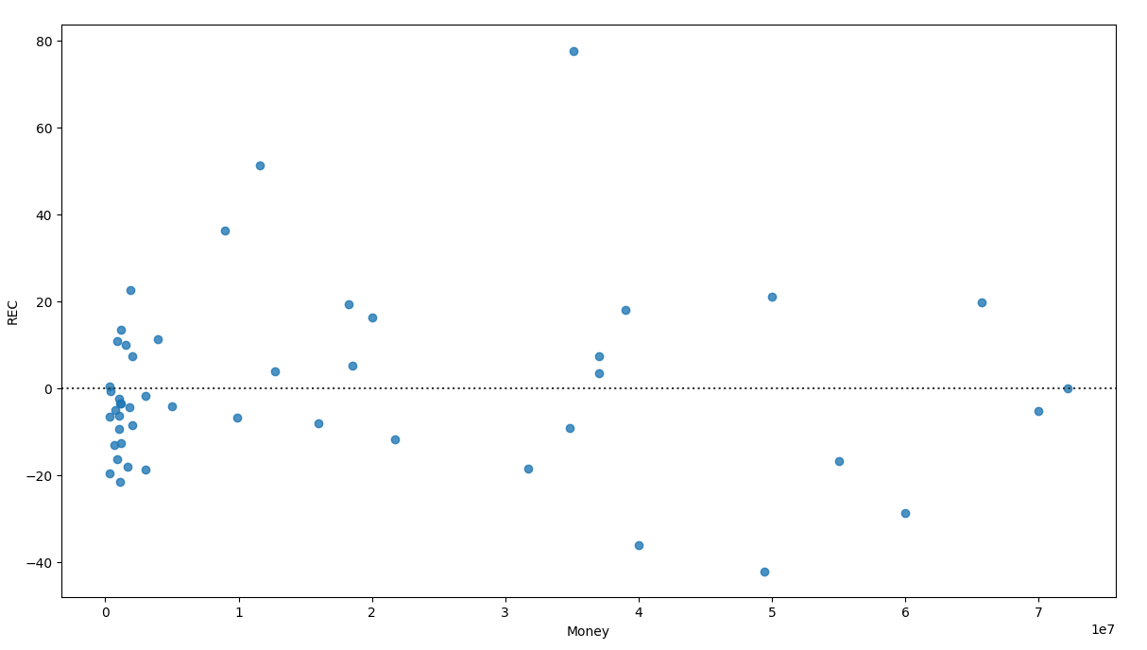
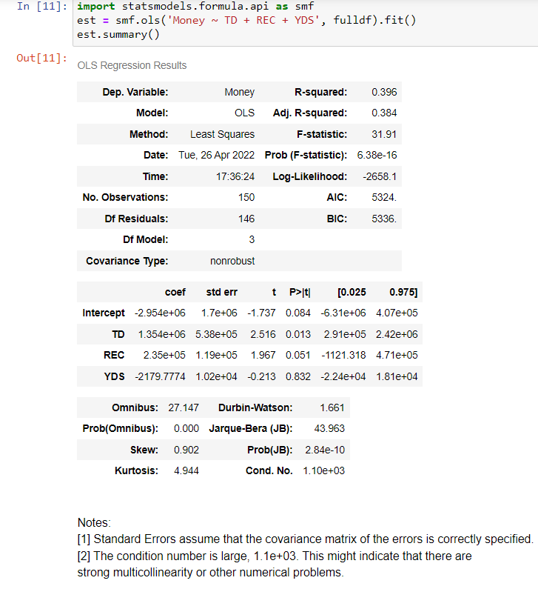
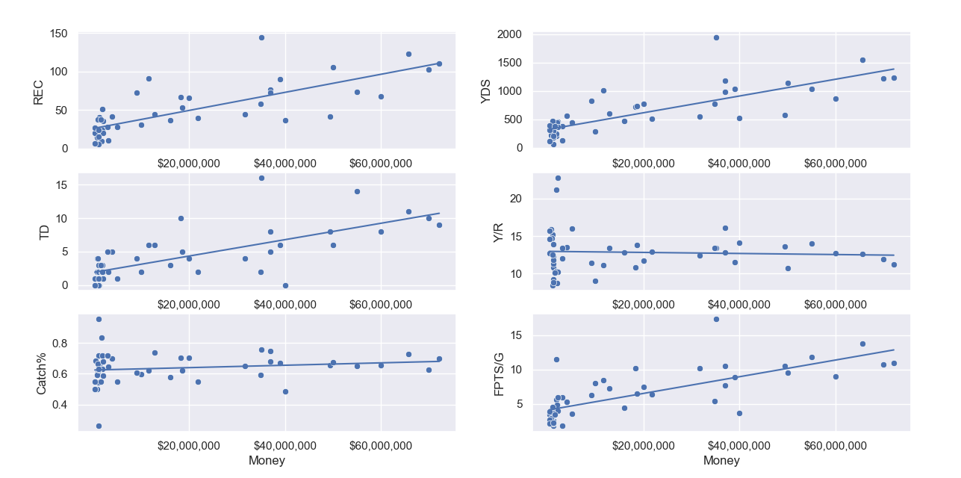
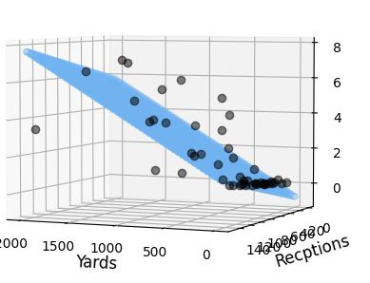
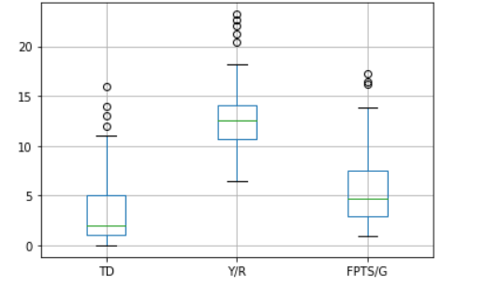
NFL Wide Receiver Contracts Compared to Performance
Ty Brunner, Tyler McCulla
Auburn University
Our model took in all relevant wide receiver contracts i.e. players who played a significant enough minutes, and we took their YDS, REC, TDs, Catch%, and FPTS/G and used these performance metrics to determine if there was a strong relationship that existed between how much a player produces and how much they earn. We concluded that the NFL players are not payed completely in accordance with what they are worth.
Determine whether guaranteed contract value is predicated on player performance
Abstract
Objectives
Results
We used our residual plot seen below to determine if there was a better line of best fit for our data and decided there wasn’t.
NPY
POMC
Going forth with this in mind we can see a very strong relationship
Methods
Use python to find test statistics
NPY
POMC
Background/Intro
We grabbed our data from the fantasy pros site and over the cap. The outstanding outliers in our data group was our rookie contracts which were salaries which strictly WEREN’T based of prior performance, so we dropped those values and began our analysis.
between our Money value and our volume statistics e.g. Touchdowns, Yards, and Receptions. Even though there exists a strong linear relationship between these values, it is not enough to say concretely that guaranteed contract value is based on performance
Use python to plot and observe model
Future Directions
All of our data contained a number of statistical outliers. In the future our aim would be to control and account for them in our model.

